Slide 1
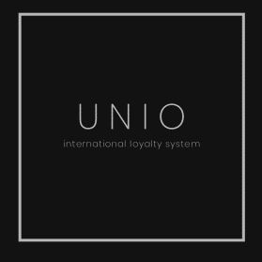
Increasing customers loyalty with UNIO
A real infrastructure of clients benefits motivation

Slide 2




Key clients challenges
Clients hold
Increasing ARPU
Increasing NPS
Best value proposition

Slide 3





A real infrastructure of clients benefits motivation
International Loyalty System working alongside with yours
Moneyback
Prizes
Promo
Lowers clients migration
Increasing NPS
Brand loyalty
Increases involvement
Increases NPS
Brand loyalty
Lead generation
Expensive check
Background
Payment infrastructure
Partnership with NEO Bank Ukraine

Slide 4









Competitive advantages UNIO
We pay to the client for shopping. JUST MONEY
Easy conditions of participation
Just identified clients
No bots
We don’t make any unexisting bonuses
We don’t restrict our client with promo goods
Moneyback for all shopping
Unio works with certain number of retailers and manufactures in each segment
You make the budget for your program
Unio works alongside with your loyalty system

Slide 5







How it works
Interface
Budget
Perfomance
Client
You choose your instrument
You set the budget
Moneyback for all shopping is in one system
Client is registered and verified with cards issued Unio and/or Neobank
Unio takes % as a fee
Prize randomiser on Unio side
Pop up messages for your clients
Prize
Moneyback
Promo
You set your audience
You create all conditions

Slide 6


OUR STRATEGY 2024 – 2025
500K
Active clients in each country at the first year of operation
2 million clients
15 retailers 300K+
NEXT
Moldova Poland Turkey Georgia Armenia Kazakhstan

Slide 7
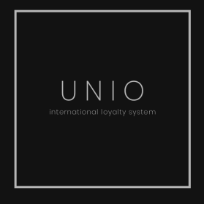
INFO@UNIO.EE
+372 8221 68 44
Estonia, Tallinn
Harju maakond
Kesklinna linnaosa
Tornimae tn 7-132, 10145

